Slide 1
Module: Memory Errors
High-level Problems
Yan Shoshitaishvili
Arizona State University

Slide 2
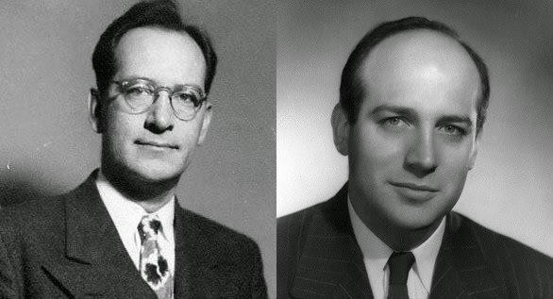
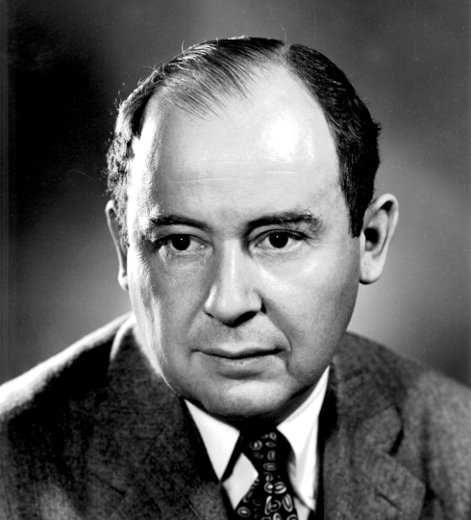
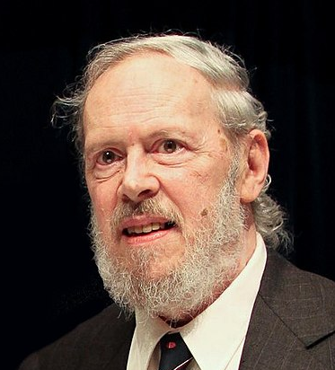

Slide 3
Problem 1: Trusting the Developer
In Python:
>>> a = [ 1, 2, 3 ]
>>> print a[10] = 0x41;
IndexError: list index out of range
In C:
int a[3] = { 1, 2, 3 };
a[10] = 0x41;
// no problem!
Why does C let this go?
What actually happens here?

Slide 4
Problem 2: Mixing Control Information and Data
Programs start up with potentially user-influenced data already present:
During execution, user data spreads through the program:
User data shouldn't directly control program execution. It is normally "non-control" data. However, it is stored together with "control" data.
.text
heap
stack
.text
heap
stack
.text
heap
stack

Slide 5
Recall: the stack
local buffer
Everything is jumbled together...
local variables of the active function
saved pointers to other places on the stack or to data in memory
saved pointers to code (return addresses)
local variables of the caller function (and its caller function and so on)
All of this data is stored together and treated the same...
int a[3] = { 1, 2, 3 };
a[10] = 0x41;
stack
local variable
saved rbp
return address
local variable
local variable
saved rbp
return address
local variable
local variable
saved rbp
return address

Slide 6
Problem 2: Mixing Control Information and Data
Memory corruption occurs when user-controlled data manages to spread into data that shouldn't be user controlled (through a memory error).
If you overwrite control data (i.e., a return address), you can use this to redirect control flow elsewhere.
Or you can also redirect it to your injected code.
.text
heap
stack
.text
heap
stack
.text
heap
stack

Slide 7

Disaster strikes!
In 1988, Robert Teppan Morris launches the first documented "buffer overflow" attack.
Accidentally brought down the entire internet.
The whole internet was taken apart and rebooted to fix it.
Morris was the first person convicted under the 1986 Computer Fraud and Abuse Act.
Now a CS professor at MIT, cofounder of Y-Combinator.

Slide 8
Problem 3: Mixing Data and Metadata
Consider: strings are null-terminated in C.
char name[10] = "Yan";
The variable holds 10 bytes:
3 of these bytes are data ("Yan"), and one (the first NULL byte) implicitly encodes the length of the data, through its position.
Consider:
read(0, name, sizeof(name));
What if there are NULL bytes in the input?
What if there are no NULL bytes in the input?
Y | a | n | \0 | \0 | \0 | \0 | \0 | \0 | \0
Y | \0 | n | _ | S | h | o | s | h | i
Y | a | n | _ | S | h | o | s | h | i

Slide 9
Problem 4: Initialization and Cleanup
If you don't clean before/up after yourself, C won't do it for you!
Initialization:
void my_function() {
char my_variable[8];
// what is the value of my_variable here? }
Cleanup:
stack
my_variable
saved rbp
return address
local variable
local variable
saved rbp
return address
local variable
local variable
saved rbp
return address

